Slide 1


Project Team :
1- Mahmoud Abdelhameed Elsaed
2- Rokia Abdulrhman Elsaedi
3-Mohamed Anwar Fouad Mahgoob
4-Mohamed Ahmed Elfeky
5-Kyrols George Sidehom Atia
6-Mohamed Hamdi Ahmed Awad

Slide 2
Agenda
Dataset overview
Data cleaning
NLP
Seq-to-seq model
Evaluation & Make predictions
Pretrained model(Ollama)
Deployment

Slide 3
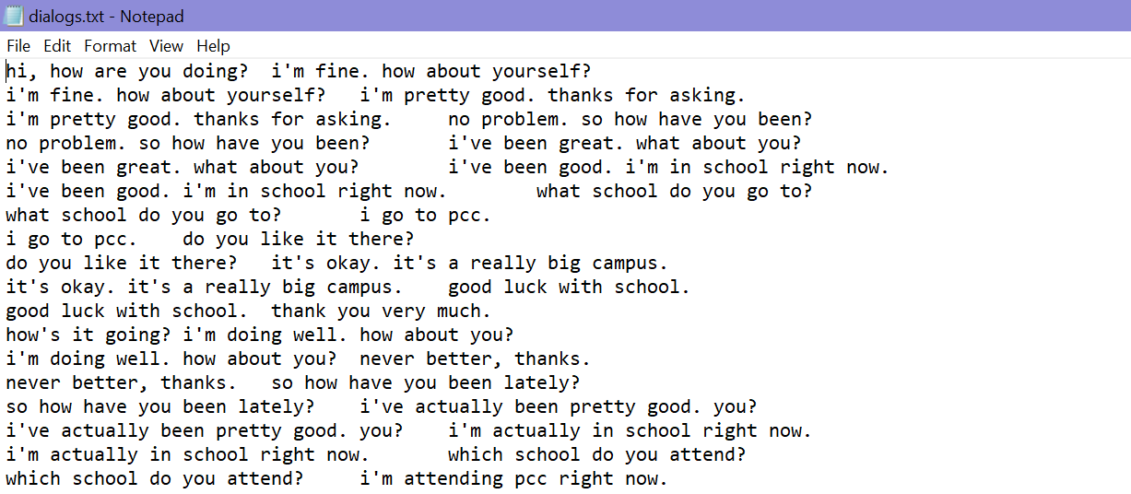
Dataset overview
Kaggle

Slide 4
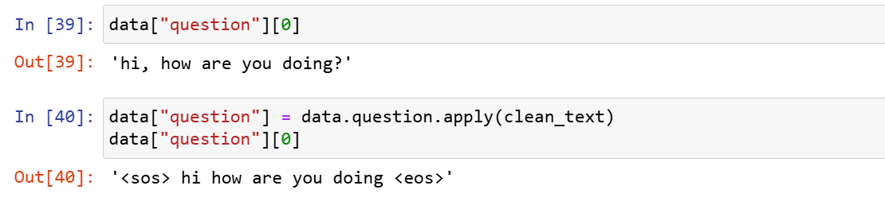
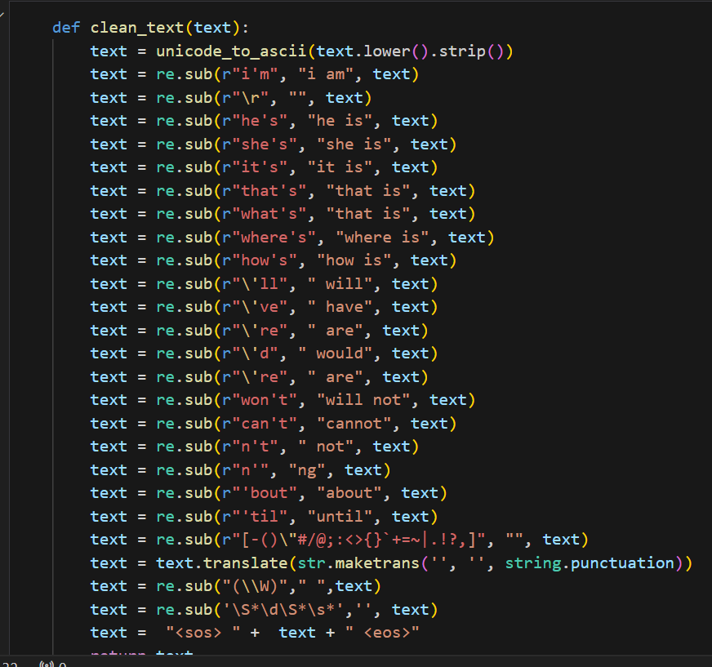
Data cleaning
Split data into Q&A
Clean text ( punctuation)

Slide 5
NLP
Apply tokenization
Remove tags from question

Slide 6
Seq-to-seq model
Encoder
Decoder
Attention
Optimizer (Adam)

Slide 7
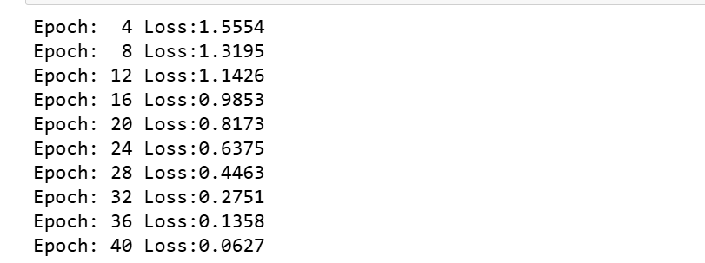
Evaluation

Slide 8

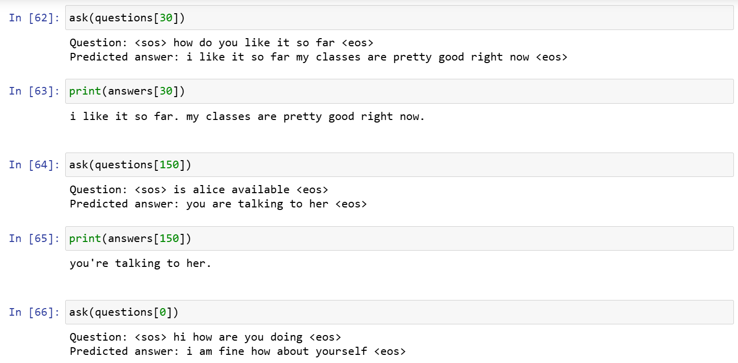
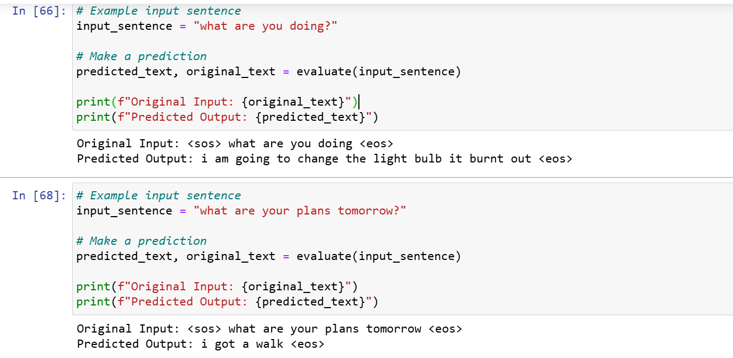
Make Predictions

Slide 9
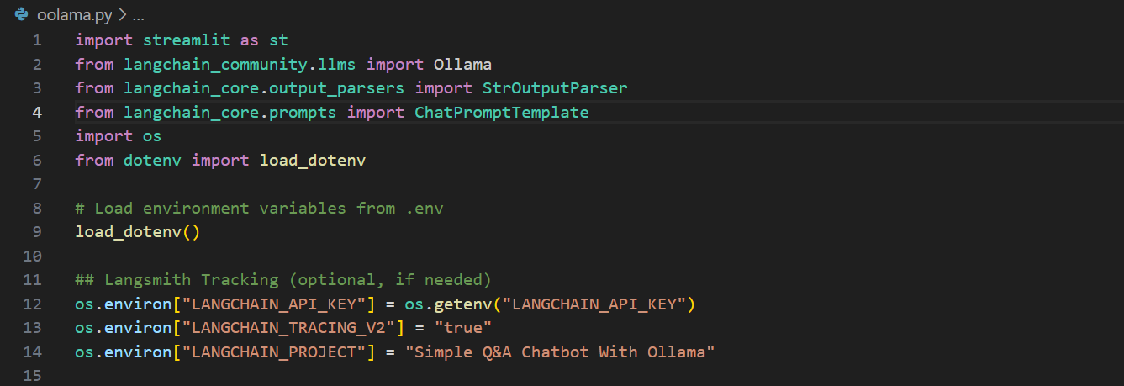
Environment Setup And Langsmith Tracking

Slide 10
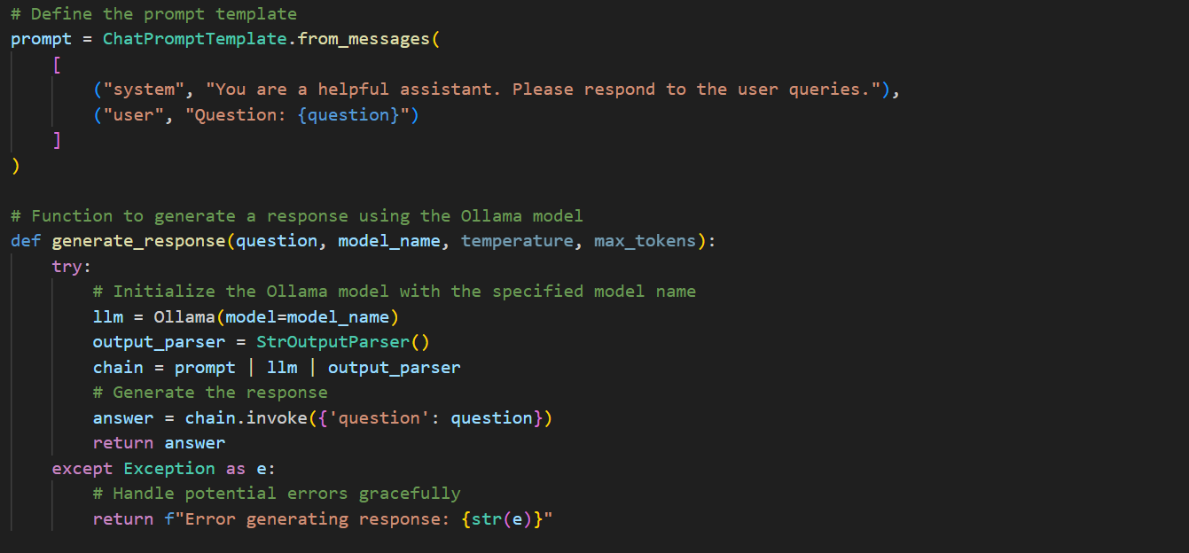
Prompt Template And Generate Response

Slide 11
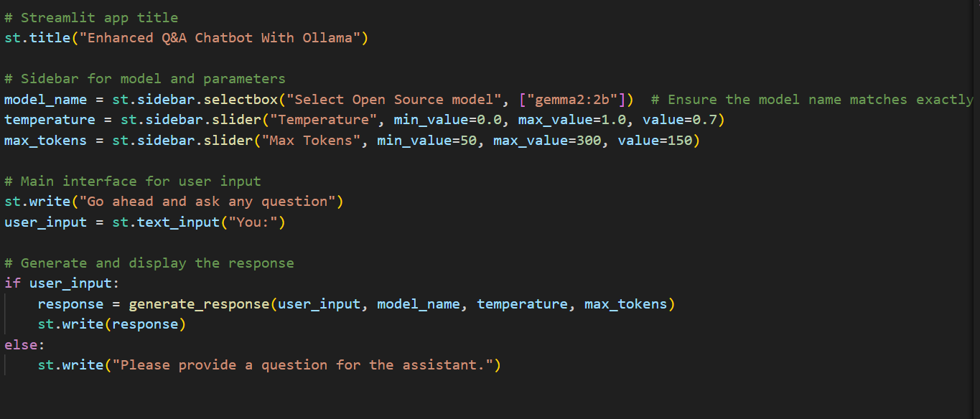
Streamlit App Layout

Slide 12
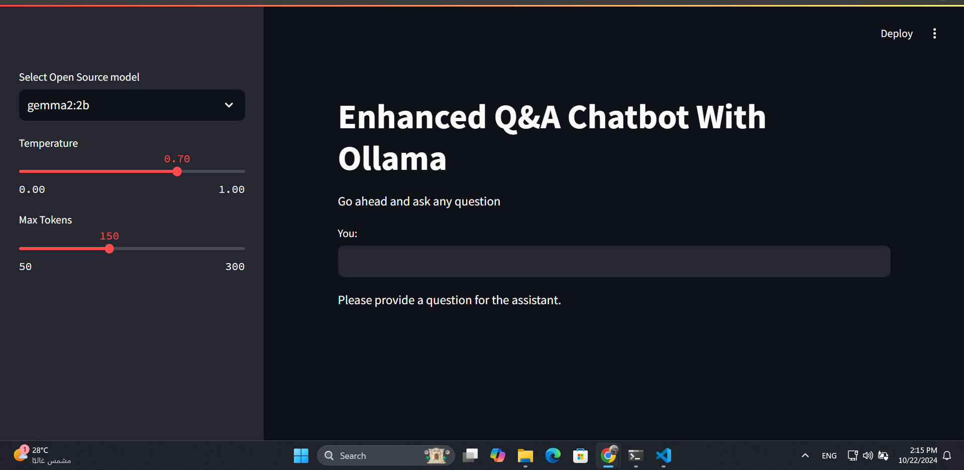
Main User Input Interface

Slide 13
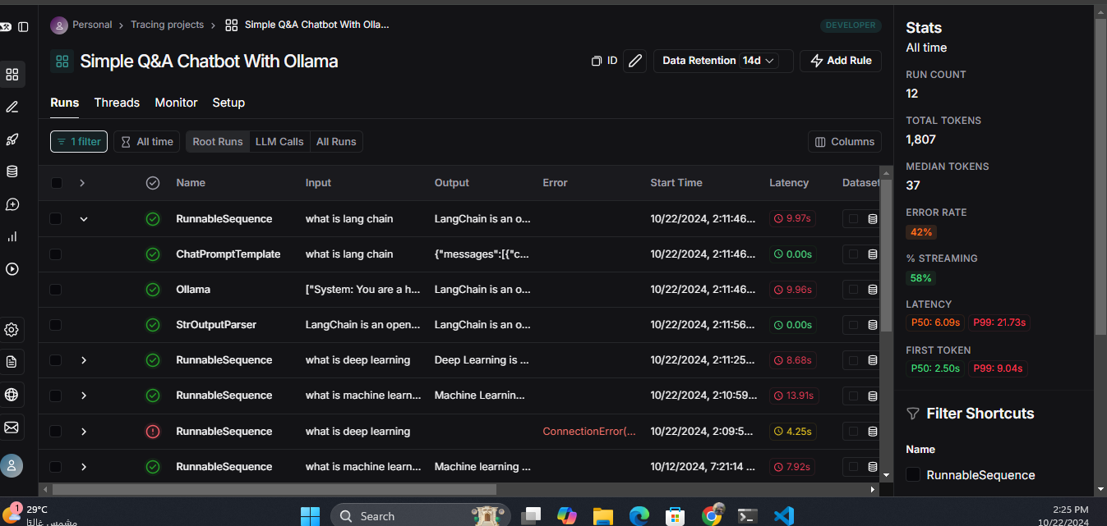
LangSmith Tracking

Slide 14
Tomorrow's Intelligence: Future AI Projects On the Horizon: RAG-Powered Solutions

Slide 15
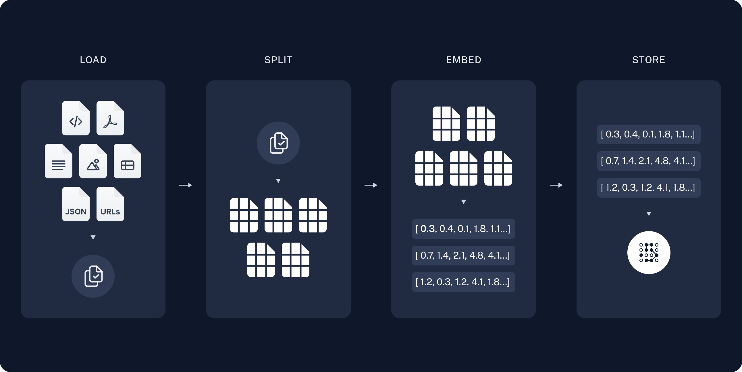
What is RAG Pipelines

Slide 16
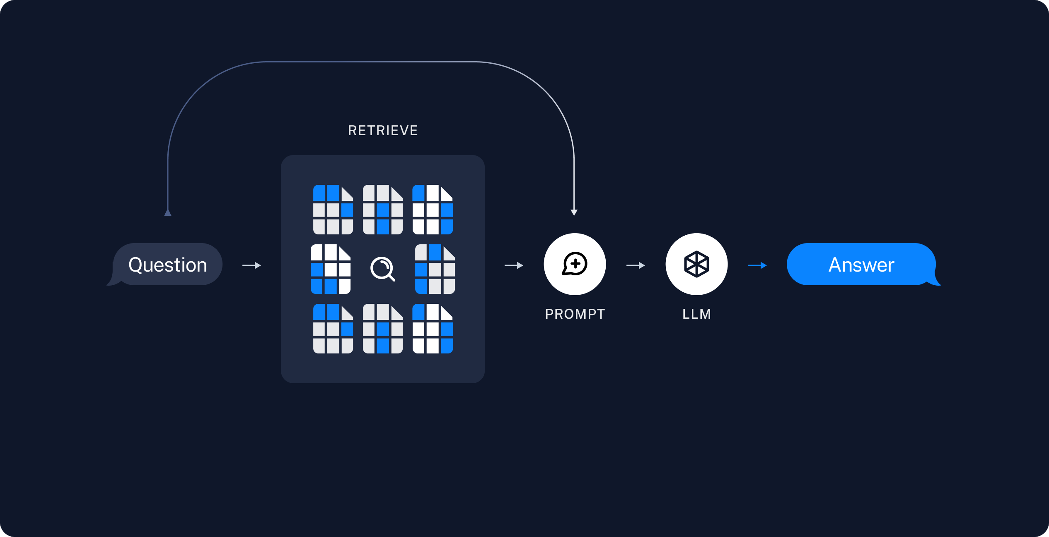
Retrieval And Generation

